Slide 1

NGO-ISAC
Dark & Deep Web Monitoring
Ian Gottesman/CEO
Email address ian@ngoisac.org | +1.202-230-7651
https://www.ngoisac.org/ membership@ngoisac.org

Slide 2
Dark Web Monitoring
The objective of this mission is to conduct a dark and deep web scan
The NGO-ISAC used specialized tools to detect if any of the organization's credentials or data have been exposed on the dark web, allowing prompt action to mitigate potential threats.

Slide 3
Closely Related Mission/Topics
Awareness Training- Starting from an overview of the threat landscape and threat actors, the training focuses on basic cybersecurity hygiene practices (phishing emails, web surfing, password, public wifi, etc.) by providing practical tips and actionable recommendations. The Institute has a cyber awareness presentation that Builders are encouraged to use and adapt if needed for the delivery of this mission.
MFA Advice- In this mission, the Beneficiary NGO receives guidance on Two-Factor Authentication (2FA) and explores the implementation of 2FA across the websites and platforms used in their daily activities. The Builders explain the benefits of 2FA, provide recommendations on suitable authentication methods, and help in the deployment of 2FA to strengthen account security and protect against unauthorized access.

Slide 4
Definitions
Dark Web– Dark Web is part of the World Wide Web content that exists on darknets: overlay networks that use the Internet but require engineering. AKA The web you can’t find via Google or a regular browser. wikipedia
Deep Web – are parts of the World Wide Web whose contents are not indexed by standard web search-engine programs. AKA you can find these things on a regular browser but not searchable via google. wikipedia
The Onion Router (TOR) – is a free overlay network for enabling anonymous communication. Built on free and open-source software using TOR browsers and TOR networks can anonymize internet communications. wikipedia
Legitimate uses ( education, journalists)
Illicit uses ( sundry and sordid )

Slide 5
Definitions
Doxxing - Doxxing refers to the release of a user’s private information
May be leaked from breach/PII
Public Information
Databases on the deep web
Public filing
Corporate Paperwork
Institutional Registration
Conference Proceedings
Publication
Government Records, 990 Forms, Government Employment or Contract Information, FOIA Request

Slide 6
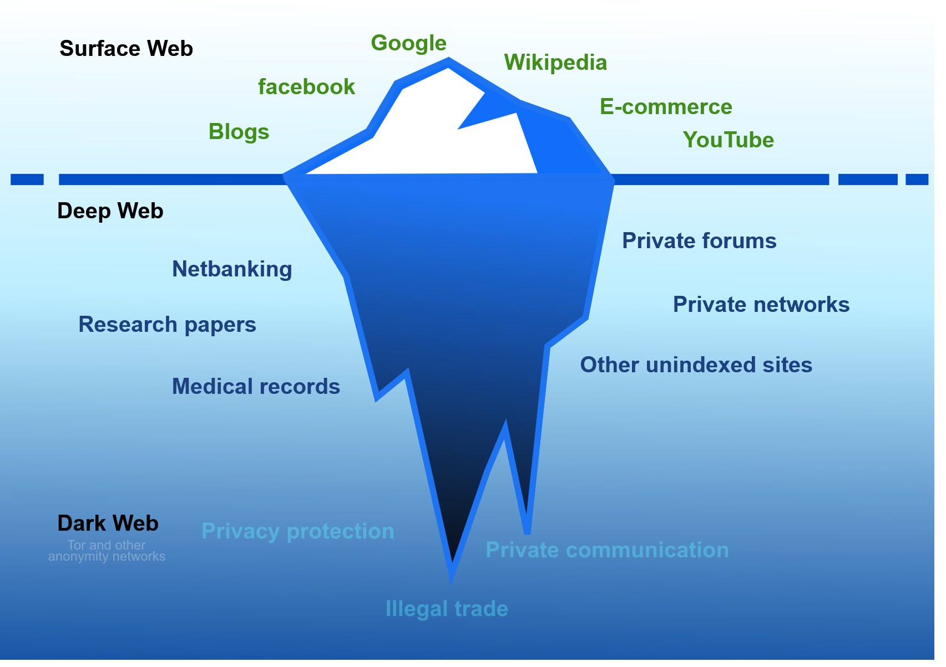
The Deep and Dark Web?
The dark web is infamous as a dangerous place, where drugs are bought and hitmen hired, passwords purchased, sold or traded. It is also an anonymous way to browse the internet.
The deep web also is hidden from most of us. It too is a mysterious place where strange things happen on the internet. It is the large databases that cannot easily be found through google but can be found using a regular browser and site specific searches.
Wired
Wikipedia

Slide 7

Kaduu
Provides CyberPeace Institute use of it's Dark and Deep Web Scanning tools. We are using that tool to scan for leaked or stolen credentials on the for your domains. You may be contacted by Kaddu or CPI volunteers if more credentials are discovered. Kaduu

Slide 8
Get Proactive
Credit freeze - attackers can use credit scams
Experian
TransUnion
Equifax
Blog entry explaining how and why to freeze your credit from our partner Tall Poppy

Slide 9
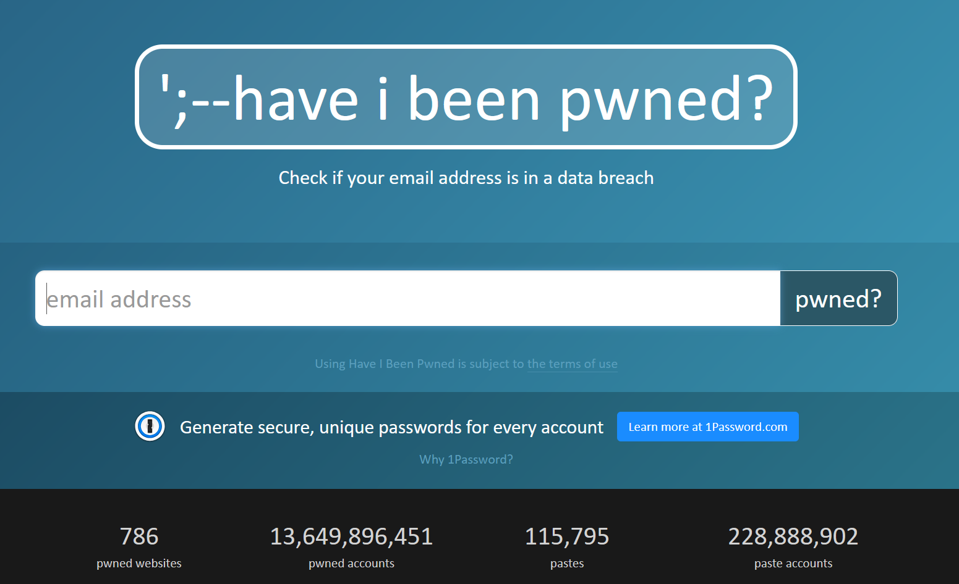
Get Proactive - Self Help
https://haveibeenpwned.com
Follow up on breach class actions
https://www.donotcall.gov/
https://securityplanner.consumerreports.org/
Remove social profiles, history
Takeouts as backups
Smurfs
Cyd a free or low cost tool to backup or move socials so you can close accounts
Public gathering opsec
Face covering
Phones off
Not airplane mode
Identifiable clothing

Slide 10
Get Reactive - Professional Help
https://alethea.com/company
https://www.tallpoppy.com/how-it-works
https://www.brightlin.es/ - urgent principal threats
Swatting Advisory - coordinated with law enforcement
https://www.aura.com/
https://flare.io/ - darkweb monitoring

Slide 11
Questions ?
Notes:
Be ready for: Constellation, Membership dues

